Slide 1
Red-Black Trees

Slide 2
Red-Black Trees
“Balanced” binary search trees guarantee an O(logn) running time
Red-black-tree
Binary search tree with an additional attribute for its nodes: color which can be red or black
Constrains the way nodes can be colored on any path from the root to a leaf:
Ensures that no path is more than twice as long as any other path ⇒ the tree is balanced

Slide 3
Example: RED-BLACK-TREE
26
17
41
NIL
NIL
30
47
38
NIL
50
NIL
NIL
NIL
NIL
NIL
For convenience we use a sentinel NIL[T] to represent all the NIL nodes at the leafs
NIL[T] has the same fields as an ordinary node
Color[NIL[T]] = BLACK
The other fields may be set to arbitrary values

Slide 4
Red-Black-Trees Properties
(**Satisfy the binary search tree property**)
Every node is either red or black
The root is black
Every leaf (NIL) is black
If a node is red, then both its children are black
No two consecutive red nodes on a simple path
from the root to a leaf
For each node, all paths from that node to descendant leaves contain the same number of black nodes

Slide 5
Black-Height of a Node
h = 4
bh = 2
26
h = 1
bh = 1
h = 3
bh = 2
17
41
NIL
NIL
h = 2
bh = 1
h = 2
bh = 1
30
47
h = 1
bh = 1
38
50
h = 1
bh = 1
NIL
NIL
NIL
NIL
NIL
NIL
Height of a node: the number of edges in the longest path to a leaf
Black-height of a node x: bh(x) is the number of black nodes (including NIL) on the path from x to a leaf,
not counting x

Slide 6
Most important property of Red-Black-Trees
A red-black tree with n internal nodes
has height at most 2lg(n + 1)
Thus at the root of the red-black tree:
n ≥ 2^{bh(root)} - 1
n ≥ 2^{h/2} - 1
log(n+1) ≥ h/2
h ≤ 2 log(n + 1)
Thus h = O(lg n)

Slide 7
Operations on Red-Black-Trees
The non-modifying binary-search-tree operations MINIMUM, MAXIMUM, SUCCESSOR, PREDECESSOR, and SEARCH run in O(h) time
They take O(lgn) time on red-black trees
What about TREE-INSERT and TREE-DELETE?
They will still run on O(lgn)
We have to guarantee that the modified tree will still be a red-black tree

Slide 8
INSERT
INSERT: what color to make the new node?
Red? Let’s insert 35!
Property 4 is violated: if a node is red, then both its children are black
Black? Let’s insert 14!
Property 5 is violated: all paths from a node to its leaves contain the same number of black nodes
26
17
41
30
47
38
50

Slide 9
DELETE
26
17
41
DELETE: what color was the
node that was removed? Black?
Every node is either red or black
The root is black
Every leaf (NIL) is black
If a node is red, then both its children are black
For each node, all paths from the node to descendant leaves contain the same number of black nodes
30
47
38
50
OK!
Not OK! If removing the root and the child that replaces it is red
OK!
Not OK! Could change the
black heights of some nodes
Not OK! Could create
two red nodes in a row

Slide 10
Rotations
Operations for re-structuring the tree after insert and delete operations on red-black trees
Rotations take a red-black-tree and a node within the tree and:
Together with some node re-coloring they help restore the red-black-tree property
Change some of the pointer structure
Do not change the binary-search tree property
Two types of rotations:
Left & right rotations

Slide 11
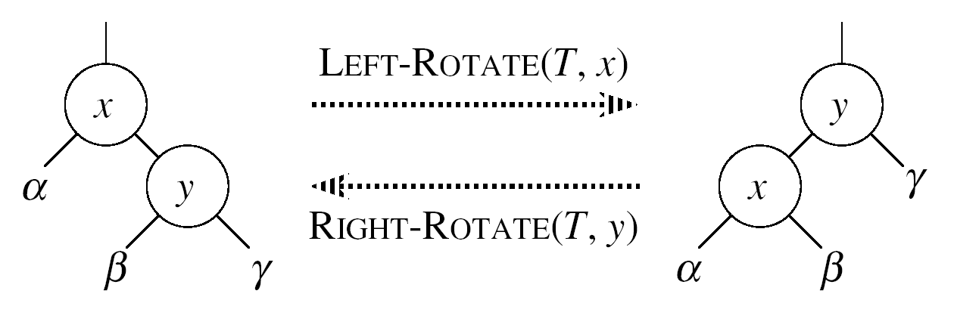
Left Rotations
Assumptions for a left rotation on a node x:
The right child of x (y) is not NIL
Idea:
Pivots around the link from x to y
Makes y the new root of the subtree
x becomes y’s left child
y’s left child becomes x’s right child

Slide 12
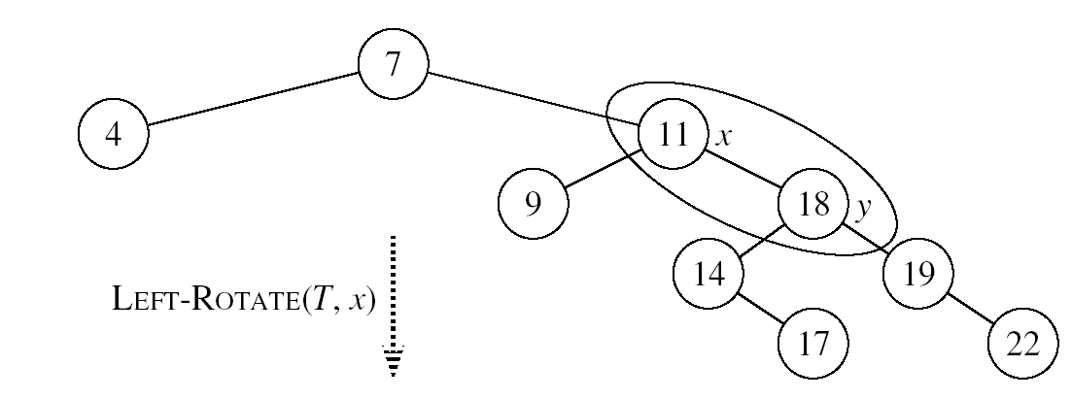
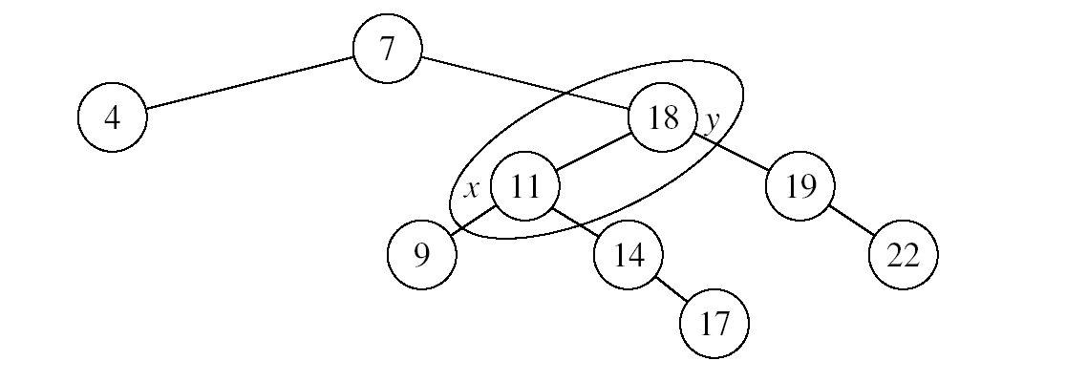
Example: LEFT-ROTATE

Slide 13
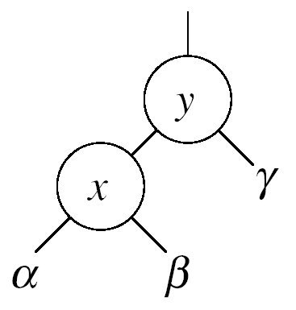
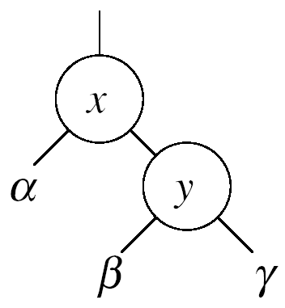


Right Rotations
Assumptions for a right rotation on a node x:
The left child of y (x) is not NIL
Idea:
Pivots around the link from y to x
Makes x the new root of the subtree
y becomes x’s right child
x’s right child becomes y’s left child

Slide 14
Insertion
Goal:
Insert a new node z into a red-black-tree
Idea:
Insert node z into the tree as for an ordinary binary search tree
Color the node red
Restore the red-black-tree properties
Use an auxiliary procedure RB-INSERT-FIXUP

Slide 15
RB Properties Affected by Insert
OK!
Every node is either red or black
The root is black
Every leaf (NIL) is black
If a node is red, then both its children are black
For each node, all paths
from the node to descendant
leaves contain the same number
of black nodes
If z is the root
⇒ not OK
OK!
If p(z) is red ⇒ not OK
z and p(z) are both red
OK!
26
17
41
38
47
50

Slide 16
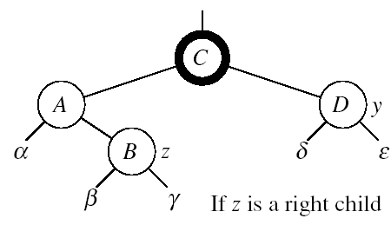
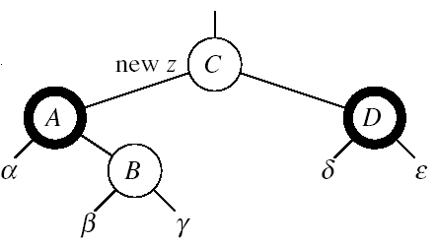

RB-INSERT-FIXUP – Case 1
z’s “uncle” (y) is red
Idea: (z is a right child)
p[p[z]] (z’s grandparent) must be black: z and p[z] are both red
Color p[z] black
Color y black
Color p[p[z]] red
z = p[p[z]]
Push the “red” violation up the tree

Slide 17
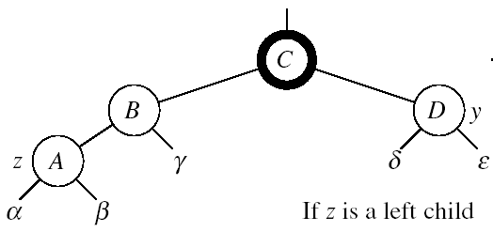
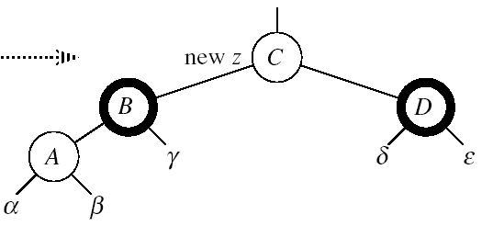

RB-INSERT-FIXUP – Case 1
z’s “uncle” (y) is red
Idea: (z is a left child)
p[p[z]] (z’s grandparent) must be black: z and p[z] are both red
color p[z] ← black
color y ← black
color p[p[z]] ← red
z = p[p[z]]
Push the “red” violation up the tree

Slide 18
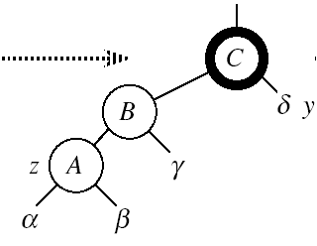

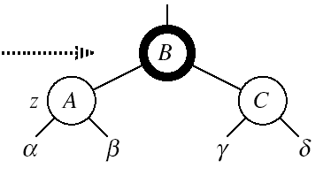
RB-INSERT-FIXUP – Case 3
Case 3:
z’s “uncle” (y) is black
z is a left child
Idea:
color p[z] ← black
color p[p[z]] ← red
RIGHT-ROTATE(T, p[p[z]])
No longer have 2 reds in a row
p[z] is now black
Case 3

Slide 19
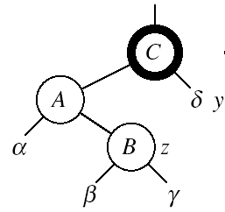
RB-INSERT-FIXUP – Case 2
Case 2:
z’s “uncle” (y) is black
z is a right child
Idea:
z ← p[z]
LEFT-ROTATE(T, z)
⇒ now z is a left child, and both z and p[z] are red ⇒ case 3
Case 2
Case 3

Slide 20
RB-INSERT-FIXUP(T, z)
while color[p[z]] = RED
do if p[z] = left[p[p[z]]]
then y ← right[p[p[z]]]
if color[y] = RED
then Case1
else if z = right[p[z]]
then Case2
Case3
else (same as then clause with “right” and “left” exchanged)
color[root[T]] ← BLACK
The while loop repeats only when
case1 is executed: O(lgn) times
Set the value of x’s “uncle”
We just inserted the root, or
The red violation reached the root

Slide 21
Example
Insert 4
11
Case 1
11
Case 2
2
14
2
14
y
1
7
7
z
15
1
15
5
8
y
5
8
z and p[z] are both red
z’s uncle y is red
z and p[z] are both red
z’s uncle y is black
z is a right child
z
4
4
11
7
Case 3
z
7
14
y
2
11
z
2
8
15
1
5
8
14
1
5
z and p[z] are red
z’s uncle y is black
z is a left child
4
15
4

Slide 22
Analysis of RB-INSERT
Inserting the new element into the tree O(logn)
RB-INSERT-FIXUP
The while loop repeats only if CASE 1 is executed
The number of times the while loop can be executed is O(lgn)
Total running time of RB-INSERT: O(lgn)

Slide 23
Red-Black Trees - Summary
Operations on red-black-trees:
SEARCH O(h)
PREDECESSOR O(h)
SUCCESOR O(h)
MINIMUM O(h)
MAXIMUM O(h)
INSERT O(h)
DELETE O(h)
Red-black-trees guarantee that the height of the tree will be O(lgn)

Slide 24
rbInsert(x)
treeInsert(x);
x->color = RED;
// Move violation of #3 up tree, maintaining #4 as invariant:
while (x!=root && x->p->color == RED)
if (x->p == x->p->p->left)
y = x->p->p->right;
if (y->color == RED)
x->p->color = BLACK;
y->color = BLACK;
x->p->p->color = RED;
x = x->p->p;
else // y->color == BLACK
if (x == x->p->right)
x = x->p;
leftRotate(x);
x->p->color = BLACK;
x->p->p->color = RED;
rightRotate(x->p->p);
else // x->p == x->p->p->right
(same as above, but with
“right” & “left” exchanged)
Case 1
Case 2
Case 3

Slide 25
rbInsert(x)
treeInsert(x);
x->color = RED;
// Move violation of #3 up tree, maintaining #4 as invariant:
while (x!=root && x->p->color == RED)
if (x->p == x->p->p->left)
y = x->p->p->right;
if (y->color == RED)
x->p->color = BLACK;
y->color = BLACK;
x->p->p->color = RED;
x = x->p->p;
else // y->color == BLACK
if (x == x->p->right)
x = x->p;
leftRotate(x);
x->p->color = BLACK;
x->p->p->color = RED;
rightRotate(x->p->p);
else // x->p == x->p->p->right
(same as above, but with
“right” & “left” exchanged)
Case 1: uncle is RED
Case 2
Case 3

